Slide 1

Modern Education Society's Wadia College of Engineering, Pune-411001 Branch-Computer Engineering Subject- Internship Academic Year 2023-24
College Student Club
Website
Mr. G. S. Pole
Internship Guide
Internship Co-Ordinator
Dr. (Mrs.) N. F. Shaik
HOD

Slide 2
Presented By:
Name Class PRN No
Shreyas Rane TE3 F21113043
Kalpesh Baviskar TE1 F21111021
Shubham Chitampalle TE1 F21111020
Aryan Chogale TE3 F21113048

Slide 3
CONTENTS
Introduction
Problem Statement and Objectives
Motivation
Advantages
Software Requirements
Methodology
Result
Conclusion
References

Slide 4
INTRODUCTION
We worked on the Website for the ACE Student club as a part of internship. ACE is Departmental Student Club which conduct different technical and non-technical events for the students.
Aimed to enhance club's online presence and provide information, events calendar, and membership registration
Used HTML for structure, CSS for styling, JavaScript for interactivity, and JSP & MYSQL for dynamic components

Slide 5
Problem Statement
ACE club lacked an effective online platform for member communication and information sharing. Manual management of events, registrations, and member communications proved difficult. This highlighted the necessity for a dynamic, user-friendly website solution.

Slide 6
Objectives
To develop a dynamic website for the ACE club with interactive features for event management, member registration, and information dissemination.
To implement responsive design principles to ensure the website is accessible and user-friendly across different devices.
To enhance user engagement through features such as discussion forums, social media integration, and personalized member experience.

Slide 7
MOTIVATION
The increasing importance of online presence for organizations like the ACE club in engaging with members and promoting events.
The potential benefits of a dynamic website in improving user experience, increasing membership, and streamlining club operations.
The opportunity to apply and demonstrate knowledge of web development technologies in a real-world context, contributing to personal and professional growth.

Slide 8
Advantages
Enhanced Communication: Centralized platform for seamless member engagement and updates.
Streamlined Operations: Automation reduces manual effort, enabling organizers to focus on event success.
Improved User Experience: Interactive features enhance navigation and member interaction.
Scalability and Flexibility: CMS allows easy adaptation to evolving club needs and growth.

Slide 9
Software Specifications
Software Requirements:
Operating System: Linux/Windows.
Front-End: HTML, CSS, JavaScript.
Back-End: Java, JSP.
Database: MySQL.
Server: Apache Tomcat.
Hardware Requirements:
System: Desktop or laptop.
Hard Disk: Minimum 250GB storage.
RAM: Minimum 4GB RAM
.

Slide 10
METHODOLOGY
Project Planning
Design and Development
Testing and Quality Assurance
Data Collection

Slide 11
Project Planning
Requirement Gathering
Scope definition
Roadmap creation
Milestones

Slide 12
Design and Development
Design
Conceptualization
Milestones
Roadmap creation

Slide 13
Testing and Quality Assurance
Testing
Integration
User Acceptance
Performance

Slide 14
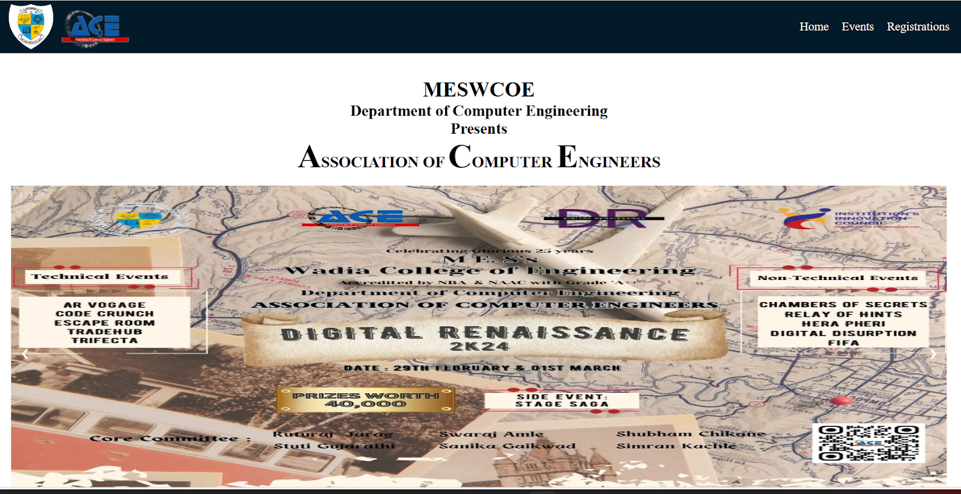
Result
Home Page:

Slide 15
Result
Events Page:

Slide 16
Result
Home Page:

Slide 17
CONCLUSION
Developed dynamic ACE club website using HTML, CSS, JavaScript, JSP, and MYSQL, achieving objectives of enhancing online presence and improving user engagement.
Overcame technical complexities and time constraints through collaborative teamwork, gaining valuable insights into agile project management and UI/UX design principles.
Identified opportunities for future enhancements, such as additional features and performance optimization, while expressing gratitude for guidance, collaboration, and support received.

Slide 18
REFERENCES
https://csi-fcrt.netlify.app
Servlet Example : Steps to create a servlet example - javatpoint
MES Wadia College of Engineering in Pune (mespune.org)
Ibrahim Mohd, Kasim Shahreen, Hassan Rohayanti, Mahdin Hairulnizam, Ramli Ts, Azizul Azhar, et al., "INFORMATION TECHNOLOGY CLUB MANAGEMENT SYSTEM", Acta Electronica Malaysia, vol. 1, pp. 01-05, 2018.
A. Rahmat and N. A. M. Hanifiah, "Usability Testing in Kanban Agile Process for Club Management System", 2020 6th International Conference on Interactive Digital Media (ICIDM), pp. 1-6, 2020.
R. Khatipov, A. Negimatzhanov, I. Zamaleev, A. Zakirov, M. Mazzara and V. Rivera, "Hikester - The Event Management Application", 2018 32nd International Conference on Advanced Information Networking and Applications Workshops (WAINA), pp. 462-468, 2018.

Slide 19
THANK YOU!!!

